Slide 1
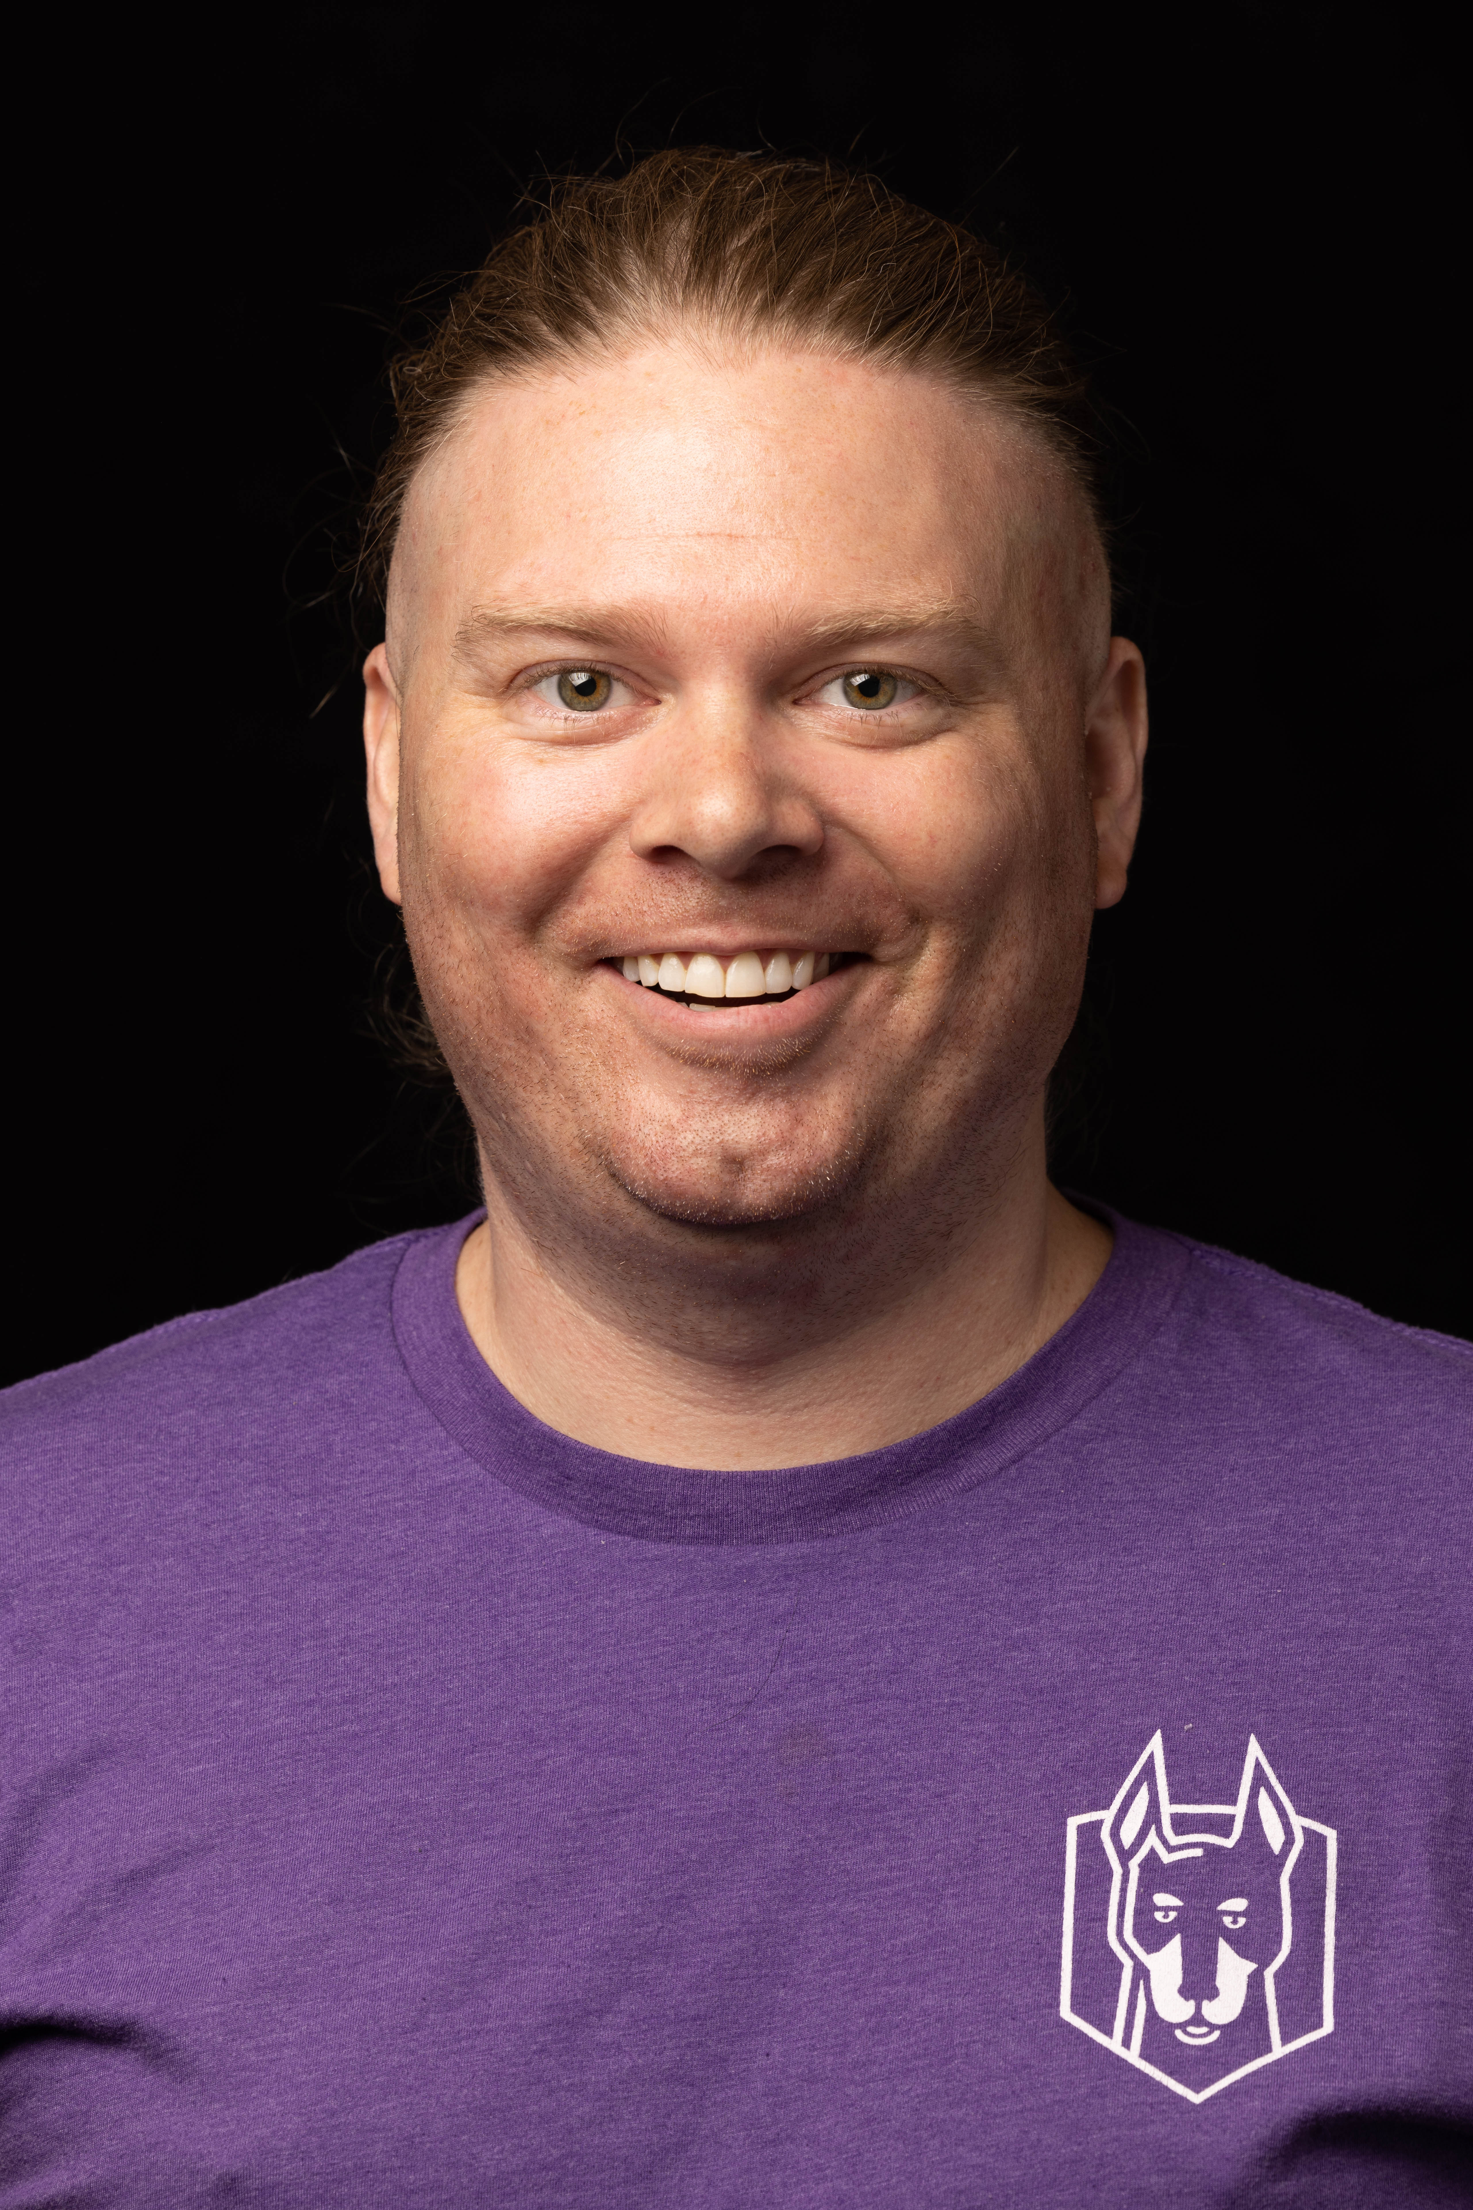

Custom Sonar Rules and Measures
Let’s discuss how we’ve created more than 40 sonar rules to help us enforce code quality and leverage a “shift-left” mentality to engineering.
Presented By: Ken Herring, 2023-09-20
GitHub: @kenherring - https://github.com/kenherring
LinkedIn: https://www.linkedin.com/in/ken-herring-b55b5287/
Email: kennethherring@gmail.com

Slide 2
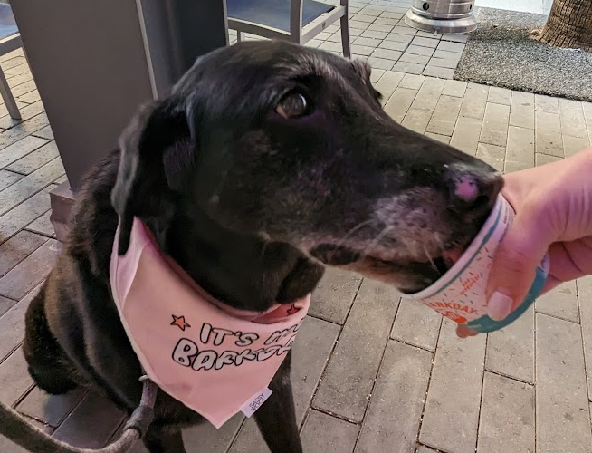
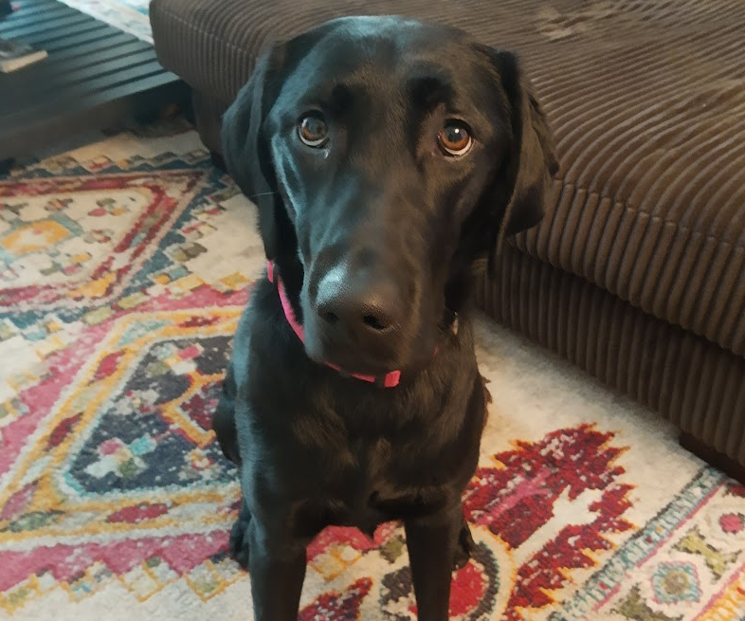
About Me
I currently live in Tampa, FL
Originally from Bethlehem, PA
I’ve been writing code my whole life
Professionally since 2010
First used OpenEdge in 2010
Started my career in ERP @ Apprise Software
Currently work for Rocket Mortgage as a Staff Software Engineer
I have two dogs: Maia and Lily

Slide 3

Agenda
What is “Shift Left”
What is SonarQube/SonarLint?
Rules We’ve Created
Leveraging Data
Sonar Measures
Team Communication
Coding Standards
Success Stories
Questions

Slide 4
Session Expectations
Audience: Everyone involved in the SDLC
Less technical
Sorry, no live demo today
GitHub Repo
kenherring/pug-rules
Learn Concepts to Improve Team Development
Takeaway:
The Value of Incremental Change

Slide 5
Tools

Slide 6

What is “Shift Left”
Shift left is the practice of moving testing activities to the left of a project timeline
Early feedback in the SDLC* provides more opportunities to increase code quality
Feedback in your IDE is the first opportunity to understand what impact a code change may have
* SDLC – Software Development Life(c)yle

Slide 7

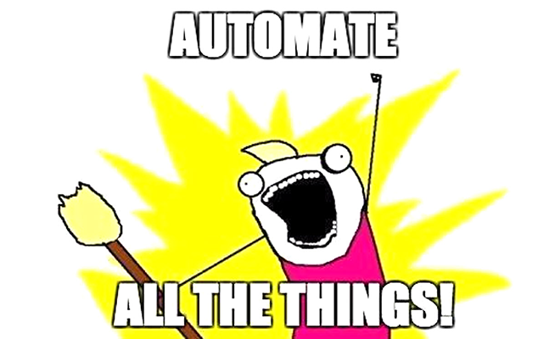
What is SonarQube?
SonarQube
Source code analysis tool
Linting, but cooler
“Clean as you Code”
Available via Docker
Test out ideas with little cost
Develop locally
Automate all the things!
Important component of PR checks
Sonar scan results on pull requests

Slide 8

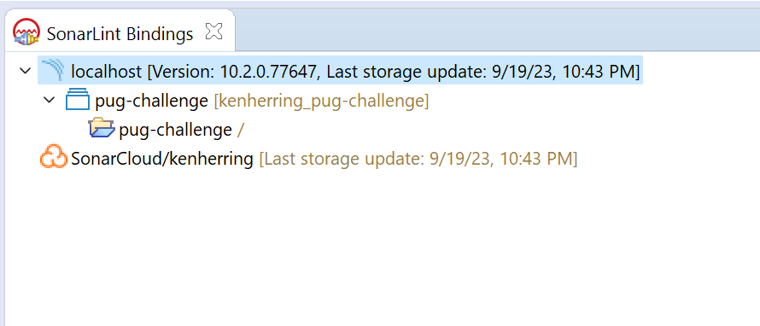
What is SonarLint?
See sonar issues directly in your IDE
Get feedback as you type
Compatible with Progress Developer Studio
Compatible with VSCode, but not for custom rules
Functionality to be added

Slide 9
What is CABL?
Code Analyzer for ABL in SonarQube
Provided by Riverside-Software
No relation to me, just a user!
Open Source
GitHub:
Riverside-Software/sonar-openedge
The concepts in this session are not reliant on CABL

Slide 10
Proven Use Cases

Slide 11
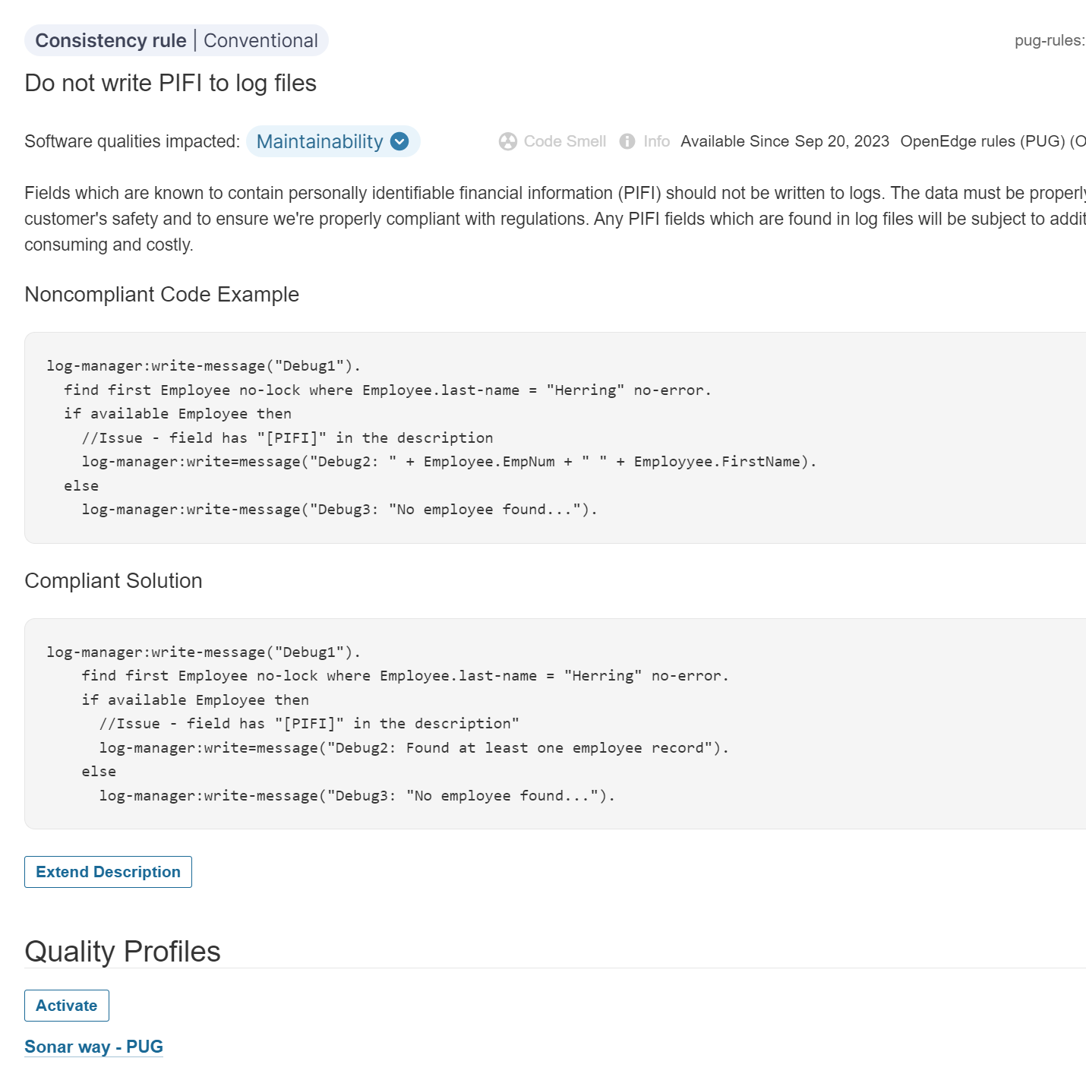
Rules We’ve Created
40+, so far…
A few examples:
Detect Unencrypted Secrets
Hardcoded References
Emails; Paths
Various PIFI/PII rules
Encryption; logging; masking
Company Name Change
Do Not Delete Cache Objects

Slide 12

Rules We’ve Created - Themes
Security/Vulnerabilities
Data Protection
PII / PIFI
Data Transfer
Code Style
Coding Standards
STOP or YIELD?
Severity level is important!

Slide 13
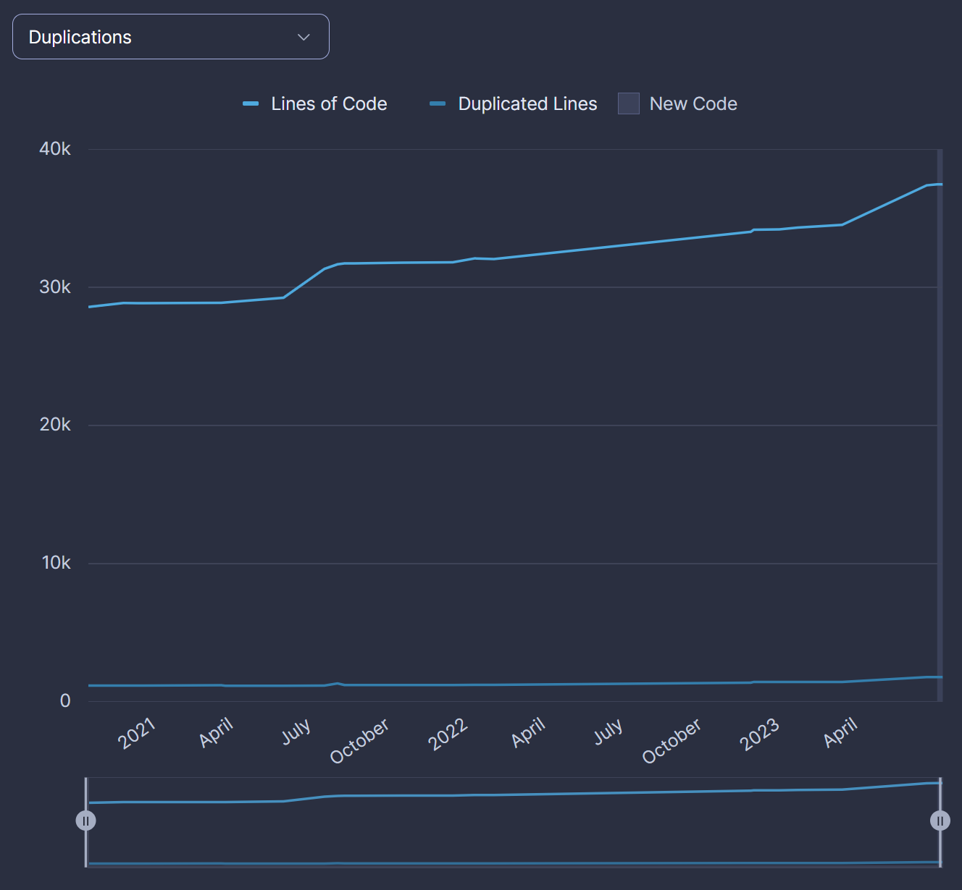
Leveraging Data
Metadata
XREF, but there’s more.
Project Decisions
Scope, timing
Answer questions from Project Managers
Data flows both ways
Sonar -> Decisions
Questions -> Sonar

Slide 14
Measures

Slide 15
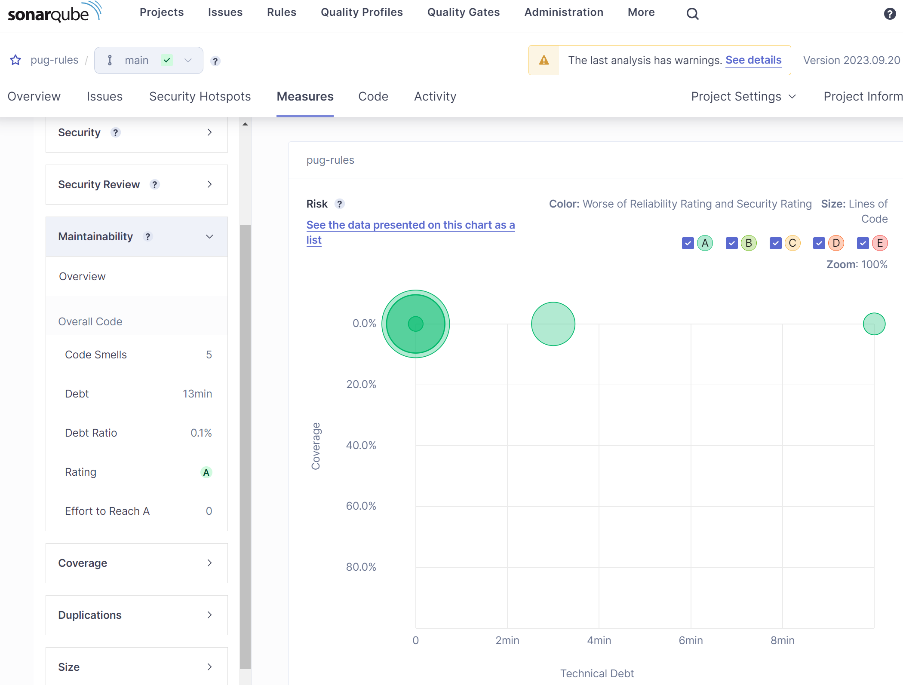
Measures
Measures provide the ability to see which way the ship is sailing
Provided Measures
Coverage
Line Counts
Duplications
Custom Measures
Imagination is the limit...

Slide 16
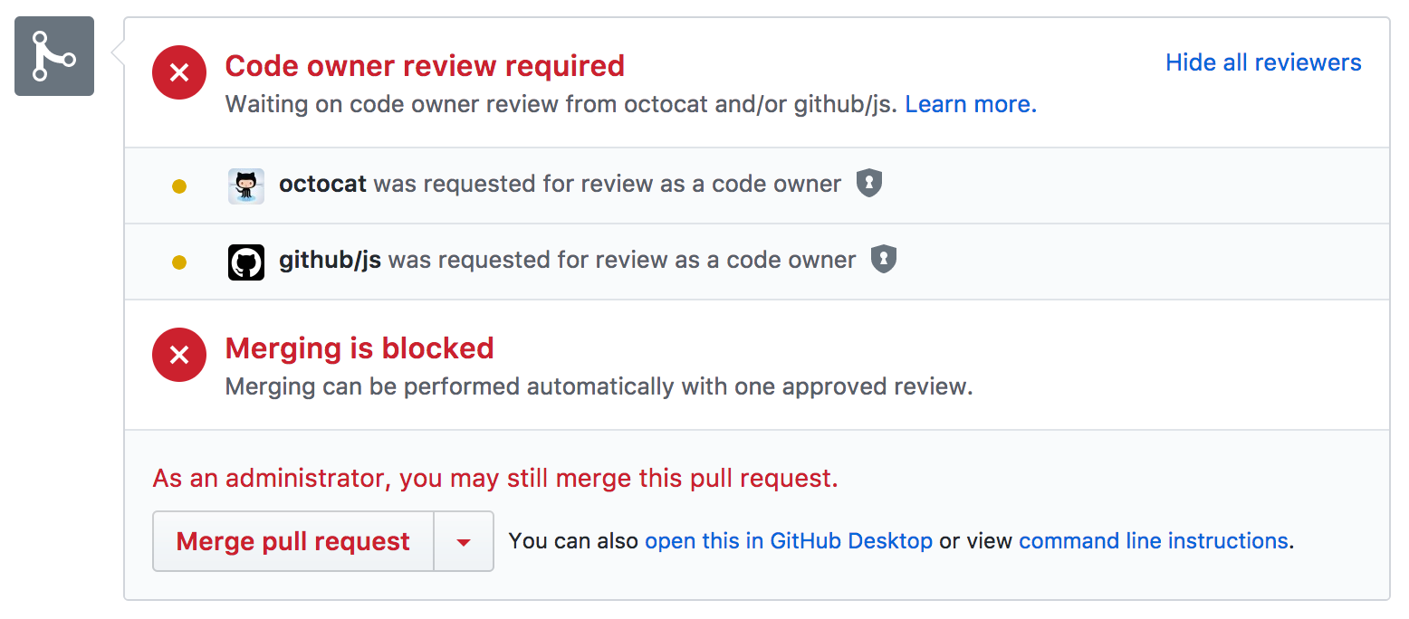
Custom Measures
Story time...
CODEOWNERS
GitHub feature
Break down a monorepo to understand functionality and ownership
What’s the status of the project? Check the SonarQube measures!

Slide 17
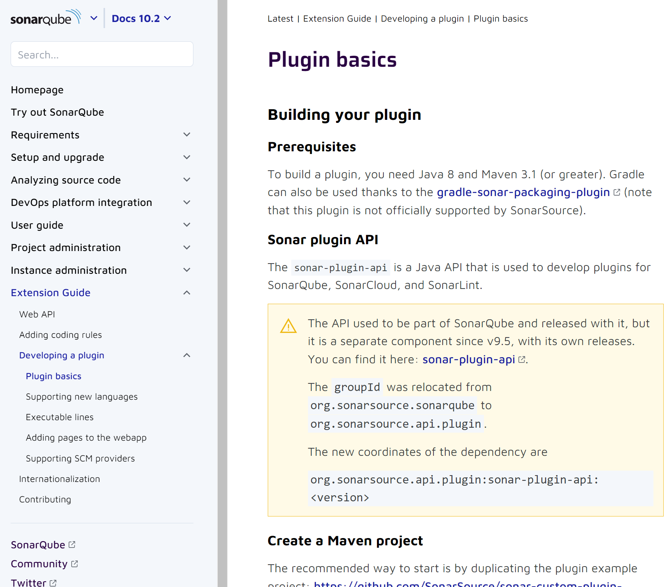
Custom Measures
Created using SonarSource/sonar-plugin-api
CABL already uses this, so it can be done in the same code base
At the start of any project…
“How do we measure success?”
The next question should be:
“Is this something that can be reported by SonarQube?"

Slide 18
Communication

Slide 19
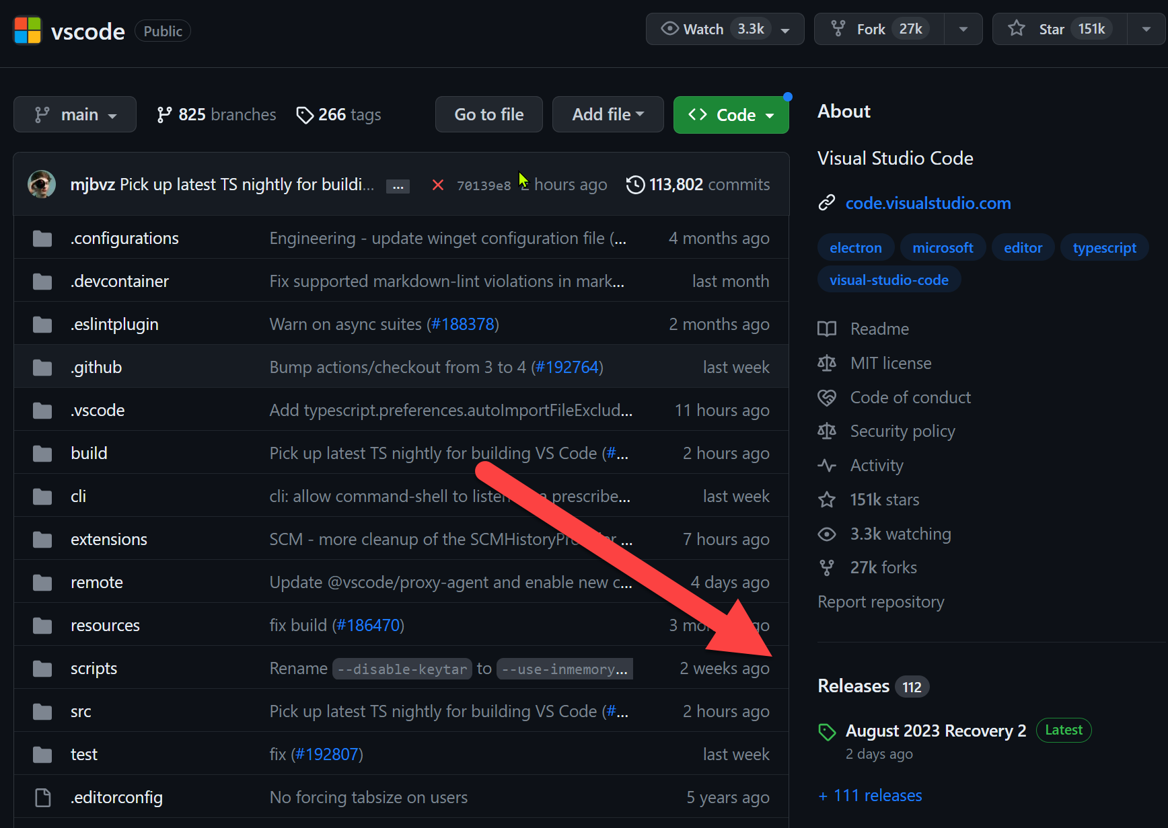
Team Communication
Repo provides a wiki/release history
Incident Evaluation Process
Can new rules prevent ‘X’?
Issues provide searchable information
Reduce duplicative conversations

Slide 20

Coding Standards
Meet each week
No gatekeeping
all are invited
“Can it be automated?”
New hires can quickly become familiar with rules/style/best practices
No fear of “breaking something”

Slide 21
Everyone dislikes pedantic people but no one dislikes pedantic robots.

Slide 22
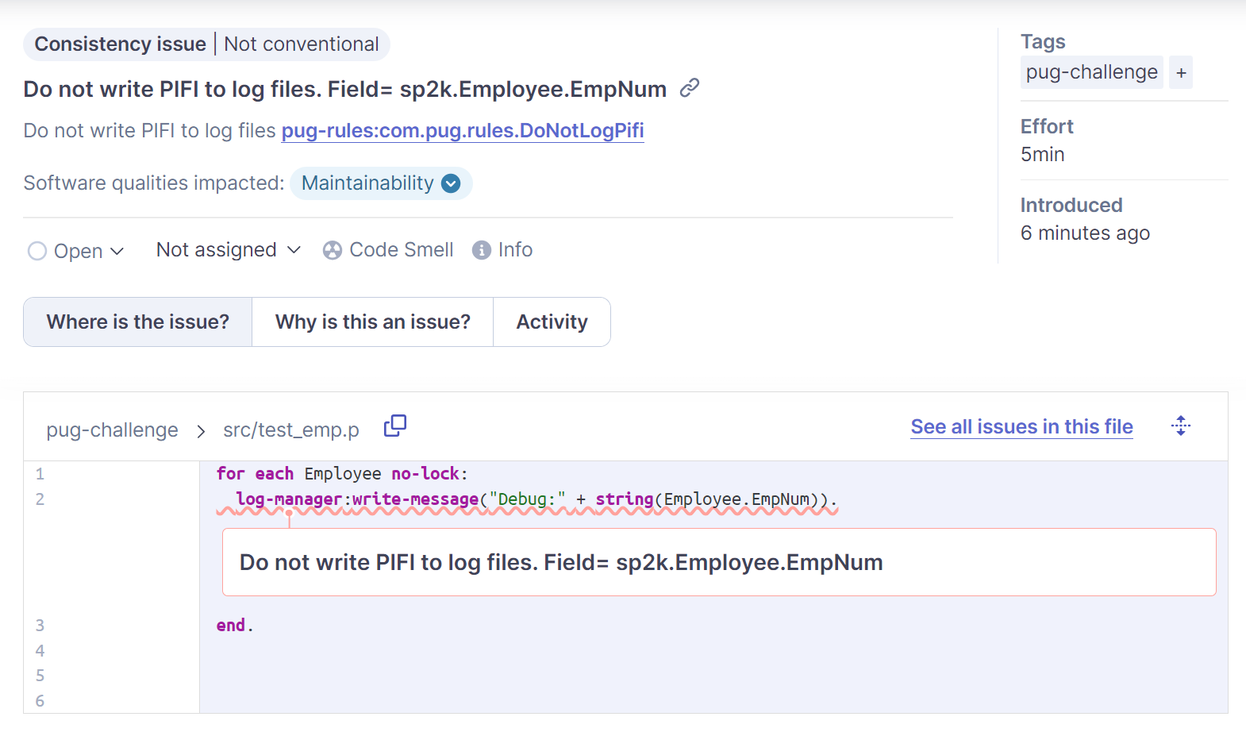
Code Review
Meet each week
No gatekeeping
all are invited
“Can it be automated?”
New hires can quickly become familiar with rules/style/best practices
No fear of “breaking something”

Slide 23
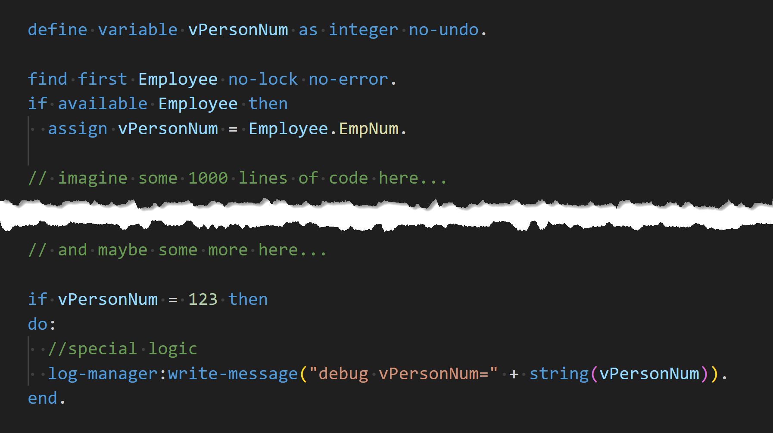
Code Review

Slide 24
Code Review

Slide 25
The Big Picture

Slide 26
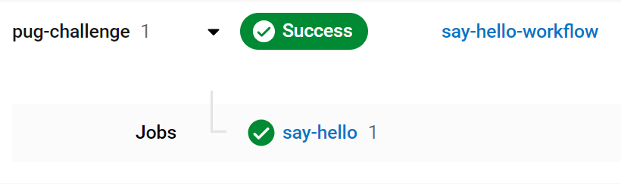
Success Stories
A recently deployed story deleted session cache for long running job
It won’t happen again!
Audit Concerns
Common Index Problems
Detect specific index/field/table combination

Slide 27
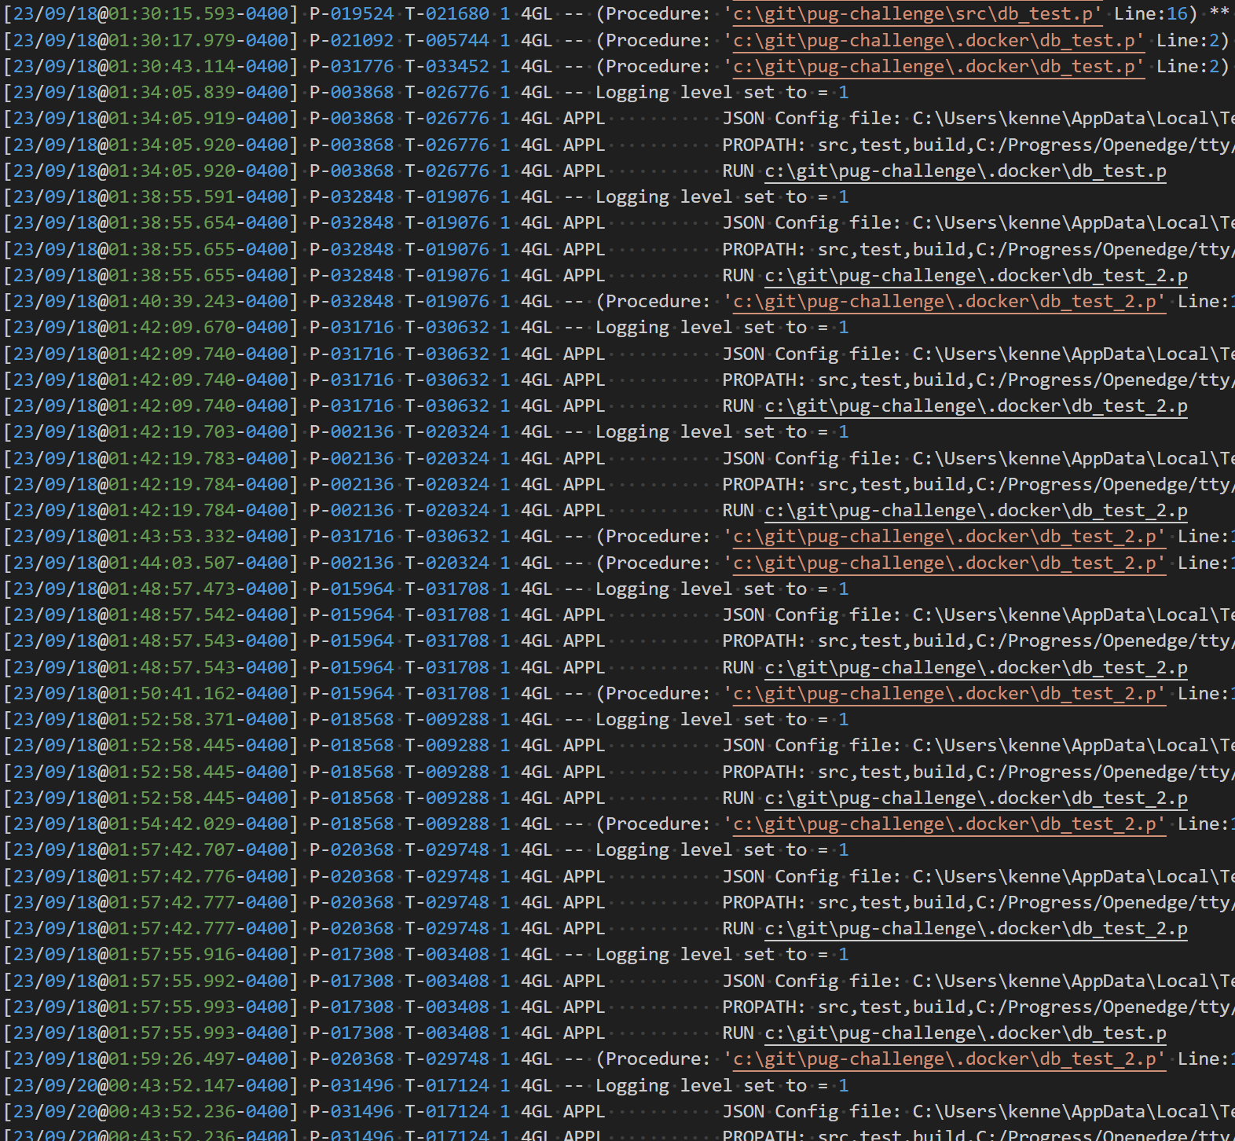
Success Stories
Log File Analysis
Where are we seeing issues?
Performance
Lack of cache in loops
Vendor Switch
Deprecate methods

Slide 28

Summary
SonarQube is a great way to understand your code and put an end to bad practices
Custom rules can improve communication, assist in decision making, and improve code quality
Success is incremental and derived from avenues of attack

Slide 29
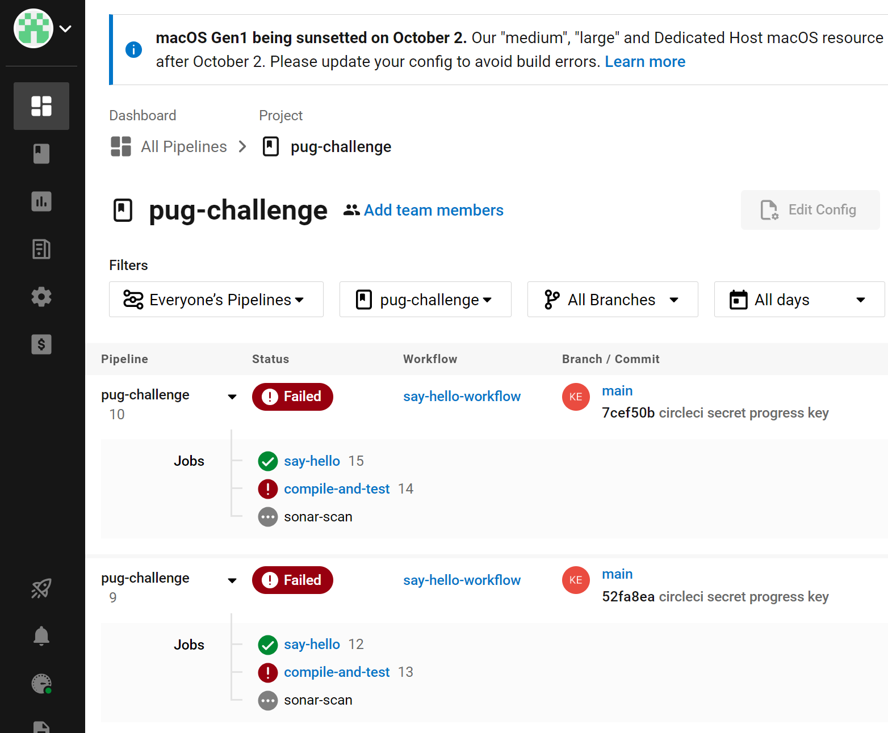
Other Sessions of Interest
VSCode
Me, Thursday 16:30-17:30
OE Build Pipelines w/ Docker
Me, Friday 11:45-12:45
Modernizing build process for OpenEdge applications using Gradle and OpenEdge DevOps Framework (OEDF)
Workshop – Thursday 09:00-12:30

Slide 30
Thank you!
I hope you enjoyed this session.
Questions?

